Slide 1
Main event
Ufc DATA and machine learning – let’s get ready to predict
Jorge Torres, Joseph Orona, Nell Meier, Daniel Jo, Elena

Slide 2
Who’s going to win- the red corner or the blue corner?
After reviewing different informative datasets, we stumbled across UFC fight data on kaggle.
The task presented itself: build a machine learning model that would predict which corner would win, the red or the blue?
But how – and the steps toward machine prediction began

Slide 3
Questions to start
Which model to use to help predict who’s going to win?
What are some factors for the model – what does the data tell us?
Age | weight | height | Win Streak
What visualizers can we use to paint a picture?
visualizations such as matplotlib
How can we interact with the data?

Slide 4
The steps
Search for a dataset that can be used
Choose visualizers to build from the data
Select the machine learning model and save the model
Utilize flask app for interaction
Deploy our model and find our prediction

Slide 5
The data
We found our dataset on kaggle:
https://www.kaggle.com/calmdownkarma/ufcdataset?select=data.csv
With over 800 columns and multiple empty spaces we analyzed, wrangled with and cleaned the data using jupyter notebook and pandas.
Reducing the data to 10 columns
For each corner: Previous wins, win streaks, age, height and weight

Slide 6
Visualizations
Some visualizations Used included: matplotlib & plotly
Exploring our data population we created some summary visualizations: (Note* weight=kg)
Grouped box plots comparing age, streak and winner
Something We ran into: large datasets can be difficult to summarize
After cleaning the data: summarizing results

Slide 7
The models
Models used
Logistic Regression
Grid Search
Tensor Flow
Saving the Model
Saved the model using JSON and h5 so we could load it post-trained and apply to a new dataset for predictions

Slide 8
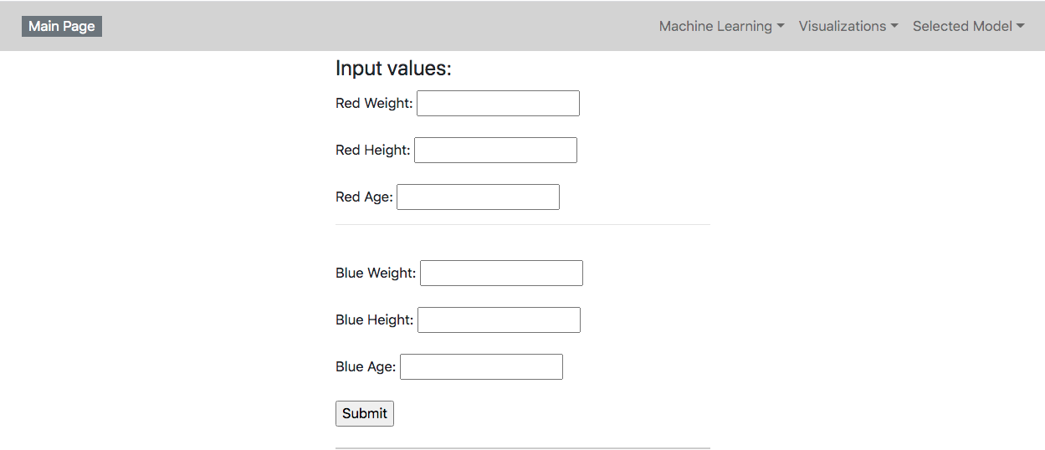
How about a demonstration!

